Slide 1
The Ethics of Punishment
Ethics
Matters
Lectures in
Applied Ethics

Slide 2
Introduction
For years, we heard calls to “get tough” about punishment.
United States already has one of the very highest percentages of its population in prison
Issues:
    Number of people in prison
    Uniform sentencing across states (Pew Report)
    Level of crime
    Life without parole to minors
    Reintegration into the community
    Private prisons
    Solitary confinement

Slide 3
A Disturbing Picture
No other country has as many people in prisons and jails.
One in 100 Adults Behind Bars (Pew Report)
National prison population tripled from 1987 to 2007
Currently 2.3 million Americans in prisons and jails
Cost of prisoner: $25K per year; $65K investment per bed
  About 1 in every 15 persons will serve time in prison during their lifetime.
  Almost 1/3 of African Americans will serve time in prison during their lifetimes; 17% of Hispanic males, 5.9% of white males.
  Men are ten times more likely to go to prison than women.
Source: http://www.ojp.usdoj.gov/bjs/crimoff.htm#lifetime

Slide 4
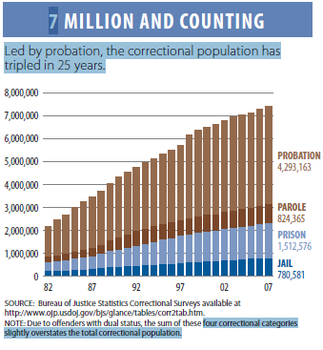
A Disturbing Picture, 2

Slide 5
And some good news . . .
New York City’s homicide rate has plummeted.
Notes:
http://www.ojp.usdoj.gov/bjs/glance/incrt.htm

Slide 6
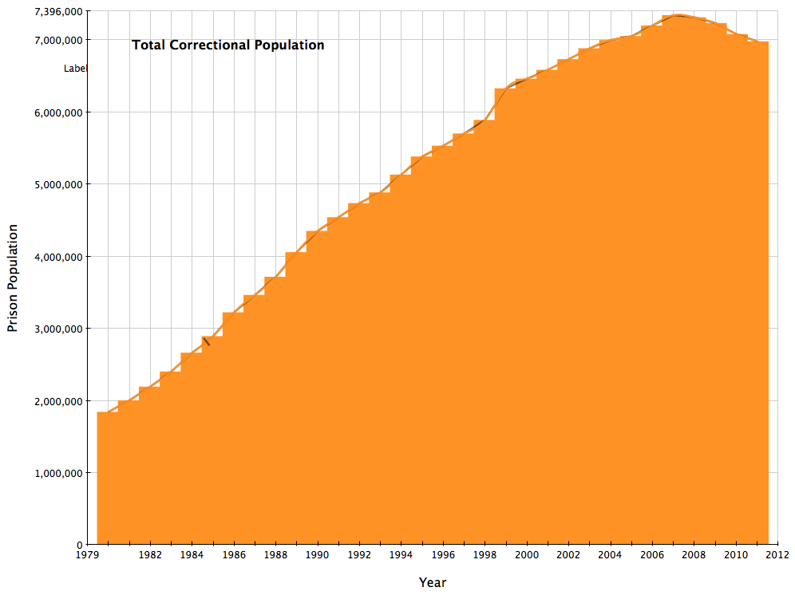
Increasing Incarceration Rate
Incarceration rates have soared during the past three decades.

Slide 7
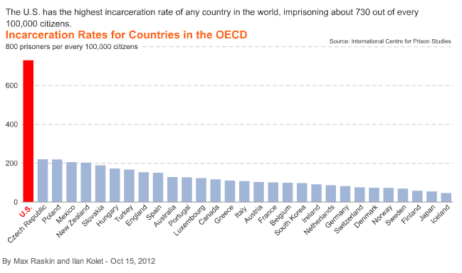
Compared with other countries . . .
Notes:
http://www.bloomberg.com/news/print/2012-10-15/u-s-jails-more-people-than-any-other-country-chart-of-the-day.html

Slide 8
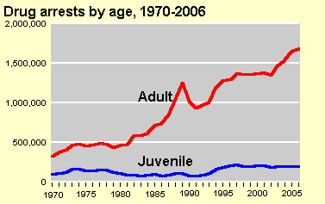
Increased Drug Arrests
The War on Drugs has resulted in increased arrests for drug-related activity and for increased numbers of drug offenders in prison.
One drug arrest every 42 seconds in the United States.
Notes:
http://www.huffingtonpost.com/2012/10/29/one-marijuana-arrest-occu_n_2041236.html

Slide 9
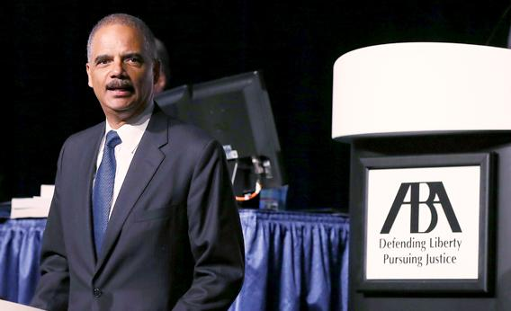
Attorney General Eric Holder’s Response
August 12, 2013
Holder maintains that we must change this system:
“While the entire U.S. population has increased by about a third since 1980, the federal prison population has grown at an astonishing rate – by almost 800 percent.”
“It’s clear – as we come together today – that too many Americans go to too many prisons for far too long, and for no truly good law enforcement reason. It’s clear, at a basic level, that 20th-century criminal justice solutions are not adequate to overcome our 21st-century challenges. And it is well past time to implement common sense changes that will foster safer communities from coast to coast.” [video link]
Notes:
http://www.justice.gov/iso/opa/ag/speeches/2013/ag-speech-130812.html

Slide 10
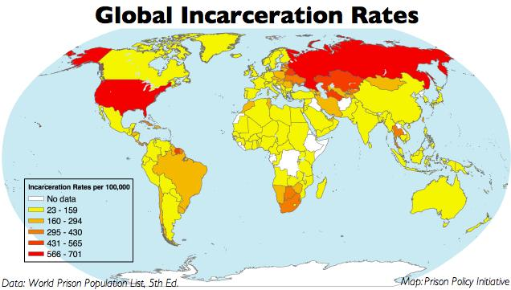
World Incarceration Rates
Notes:
http://www.prisonpolicy.org/atlas/globalincarc2004.html

Slide 11
United States Exceptionalism
Adam Liptak has an excellent series in the New York Times on how the Unites States is different in its criminal justice system from much of the rest of the world:
Highest inmate count: 5% of the world’s population, almost 25% of its prisoners;
Punitive Damages: usually not awarded in foreign civil courts;
Bail for profit;
Serving Life for Providing Car to Killers
Sentencing adolescents as adults and sentencing them to life;
Using partisan expert witnesses;
Rejecting all evidence if police err;
Freedom for offensive speech;
Electing judges.

Slide 12
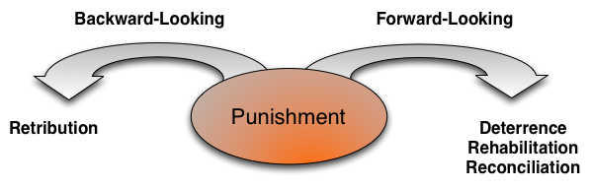
Justifications of Punishment

Slide 13
Retributivism
Lex talionis, “an eye for an eye,” “a tooth for a tooth”
Core concept: the offender should suffer at least equally to the victim

Slide 14
Is Retributivism Just Revenge?
Critics of retributivism have argued that it is just revenge dressed up in nice clothing.
Replies:
    Yes, it is revenge, but that’s ok
    No, retribution is about something more than revenge: about balancing the scales of justice, about safeguarding the rights of victims, and about changing perpetrators.

Slide 15
The Scales of Justice
Fundamental metaphor: an underlying balance which must, if upset, be put back in order
Punishment is seen as resetting the moral balance by punishing the offense
Punishment of elderly Nazis

Slide 16
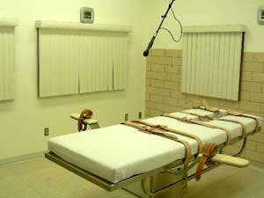
The Rights of Victims
Victims, some retributivists argue, have a right to see the perpetrators suffer their just desserts
  Example: families of victims at executions

Slide 17
The Effects on Perpetrators
Some retributivists,especially in the Kantian tradition, argue that punishment should have certain effects on the perpetrators, including
  insight into their crime, including compassion for victim
  will “wipe the slate clean”

Slide 18
Criticisms of Retributivism
Does it really justify punishment?
Lex talionis offers little guidance in specific cases of punishment
Can lead in particular cases to punishments that are cruel and that have no morally good effects

Slide 19
Deterrence
Many justify punishment as an institution by its deterrent effect
  Specific deterrence: Deters the convicted criminal from committing the same crime again
  General deterrence: Deters others from committing that crime

Slide 20
Normative and Empirical Considerations
The deterrence argument has two premises:
Empirical Premise: Punishment deters crime.
Normative Premise: Reducing crime is good.
Conclusion: Punishment is good.

Slide 21
Empirical Premise:
Punishment deters crime.
Uncontroversially true in general sense, but does it deter those who are worst criminals?
Are other means of deterrence better?
It is important to realize that, for most people, there are numerous effective deterrents that come into play long before the threat of punishment is reached, including:
  Family
  Religious community support
  Civic organizations
  Schools
  Team activities

Slide 22

Punishment and Prevention
Overall goal: Prevent crime before it happens
Punishment is often a last-ditch effort, after everything else has failed
Preventive approaches
Current approaches:
  Surveillance
  Predictive policing
Notes:
https://www.ncjrs.gov/pdffiles1/nij/grants/230404.pdf
http://www.policechiefmagazine.org/magazine/index.cfm?fuseaction=print_display&article_id=1942&issue_id=112009

Slide 23
Objections to Prevention
May be costly
May involve violations of individual rights
May be disproportionate to the offense
  Singapore example of Michael Fay being flogged
No justification for punishment where there is no chance of recurrence
May justify punishing the innocent

Slide 24
Rehabilitation
Some have objected that prisons are training schools for prisoners
May conflict with demands of retribution
May result in longer sentences in some cases, much shorter in others
May be very costly to administer

Slide 25
Reconciliation and Healing
How, after a rupture in society, do we reestablish harmony?
    Nazi war crimes trials
    Peace and Reconciliation Commission in South Africa
    Truth commissions in Latin American countries such as Chile after overthrowing dictators

Slide 26
Mixed Justifications: Rawls, 1
Justification of punishment as an institution: consequentialist
consequentialist theories are certainly correct in saying that the overall justification for punishing at all is that it has good effects for society as a whole, especially in terms of deterrence
retributivist justifications of the institution of punishment are weak and open to the charge that punishment is simply revenge dressed up in legal clothing

Slide 27
Mixed Justifications: Rawls, 2
Justification of particular types of punishment: retributivist
  Retributivism contains a doctrine of proportionality that seems appropriate in determining the nature and severity of particular punishments
  Deterrence-based accounts may be too severe

Slide 28
The Limits of Punishment
Public Notice of Offenses
Authority to Punish
Guilt
Reasonable Certitude
Equitable Administration
Proportionality
Not “cruel and unusual”

Slide 29
Punishment and Social Conditions
Many theorists are concerned that too great a concentration on punishment detracts from solving the social conditions—such as poverty--that give rise to crime.
In the United States, we have a disproportionately large percentage of people in prison

Slide 30
Punishment and Imagination
Consider punishment other than prison so that the offender
  May gain insight into the pain and suffering caused by the crime
    Drunk drivers going to accident scenes
  May be more effectively rehabilitated
    Avoids prison as a school for criminals

Slide 31
The Social Construction of Punishment
What counts as a crime depends on societal choices. Some of these appear to vary from one society to another.
  Drug use
  Sexual orientation and practices
  See Michael Foucault, Discipline and Punish

Slide 32
Continuing Issues of Punishment
Punishment of the young
Solitary confinement
Imprisonment of mentally ill
Chronic offenders
Privatization of punishment
Hard time and stun technology
Race and punishment
Force feeding

Slide 33
The Punishment of the Young
In many places in the United States, children had been tried as adults even though they are less than 18.
  In Florida, a 14 year old boy was given a sentence of life without parole for killing a 6 year old girl when he was 12 years old.
On March 1, 2005 the Supreme Court abolished the death penalty for crimes committed when the offender was less than 18 years old in Roper v. Simmons. This affected 72 persons on death row:
  • Texas: 29
  • Alabama: 14
  • Mississippi: 5
  • Ariz., La., N.C.: 4 each
  • Fla., S.C.: 3 each
  • Ga., Pa.: 2 each
  • Nev., Va.: 1
The younger the perpetrator, the greater the reason for trying to rehabilitate rather than simply punish.

Slide 34

Punishment, Torture & Solitary Confinement
Is solitary confinement a form of torture? See Atul Gawande’s discussion of this issue in The New Yorker, April 6, 2009.

Slide 35
Imprisonment of the mentally ill
The Death of Timothy Sauders. 60 Minutes. July 22, 2007 2:55 PM
  Scott Pelley investigates the death of a mentally ill inmate who died of thirst in a report that questions the plight of 300,000 other mentally ill inmates in U.S. jails.

Slide 36
Imprisonment of the Aging
Number of aging prisoners nationwide:
1981: 8,883
2012: 246,600
See ACLU, At America’s Expense: The Mass Incarceration of the Elderly (2012)

Slide 37
Chronic Offenders, 1
DOJ data on recidivism of prisoners released in 1994:
  Released prisoners with the highest re-arrest rates were robbers (70.2%), burglars (74.0%), larcenists (74.6%), motor vehicle thieves (78.8%), those in prison for possessing or selling stolen property (77.4%), and those in prison for possessing, using, or selling illegal weapons (70.2%).
  Within 3 years, 2.5% of released rapists were arrested for another rape, and 1.2% of those who had served time for homicide were arrested for homicide.
The percentages rearrested (but not necessarily guilty) for the “same category of offense for which they were most recently in prison are:
41.2% of released drug offenders
33.9% of released larcenists
23.4% of released burglars
22.0% of released assaulters
19.0% of released defrauders
13.4% of released robbers
2.5% of released rapists
Notes:
http://www.ojp.usdoj.gov/bjs/abstract/rpr94.htm
http://www.huffingtonpost.com/paul-heroux/sex-offenders-recidivism_b_976765.html

Slide 38
Chronic Offenders, 2
How do we deal with chronic offenders who will very probably commit further crimes as soon as they are released?
  Three strikes law
  Megan’s law
  Chemical castration
    Approved by California legislature in 1996 for chronic sex offenders on parole, also in Montana
  Indefinite sentences
    Confine to mental institutions after sentence is served—ok’d by supreme Court in 1997 in Kansas v. Hendricks

Slide 39
Privatization of Punishment
Punishment is a major growth industry in the United States.
More and more prisons are being built by private firms.
Private high security prisons may create need for labeling some prisoners as high risk.

Slide 40
Hard Time and Stun Technology
Can judges sentence prisoners to hard time? Any limits?
Can prison populations be controlled by stun belts?
Can juveniles be sentenced to life without the possibility of parole?

Slide 41
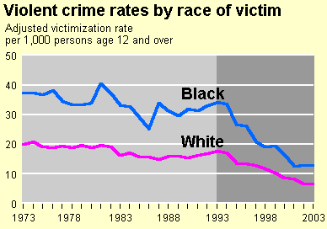
Race and Punishment, 1
Blacks are more likely than whites to be victims of violent crime.
Bureau of Justice Statistics

Slide 42
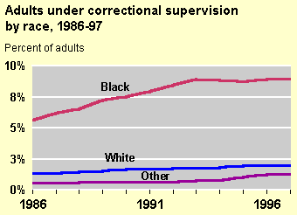
Race and Punishment, 2
In 1997, 9% of the black population in the U.S. was under some form of correctional supervision compared to 2% of the white population and over 1% of other races.
Bureau of Justice Statistics

